Slide 1
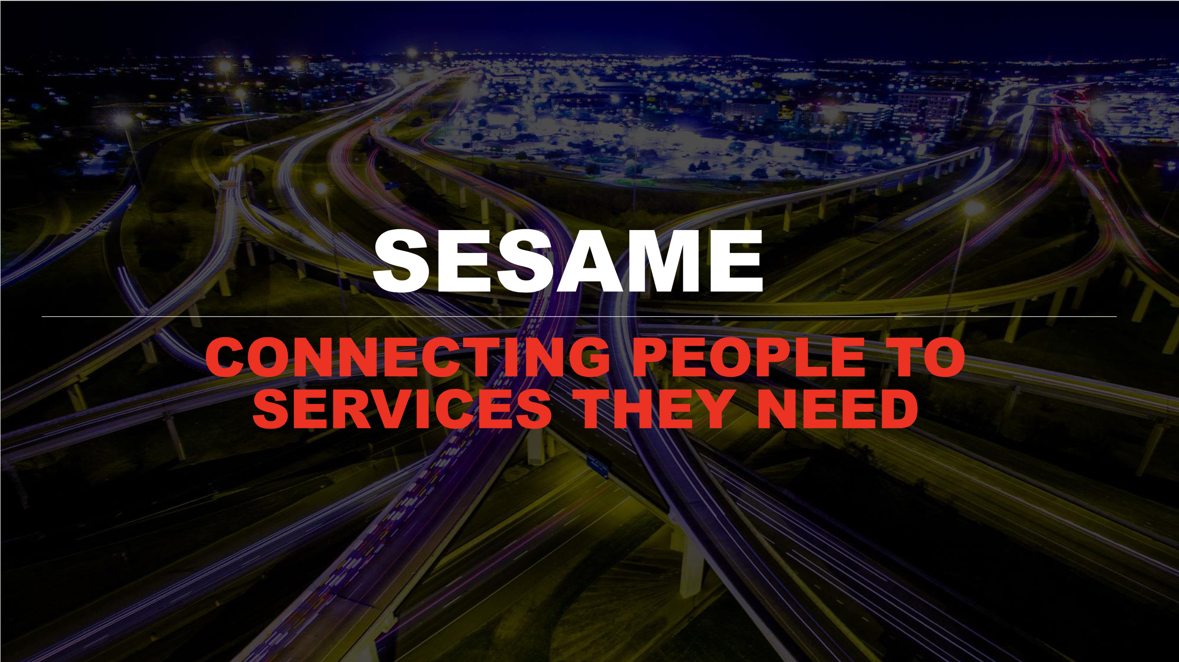

Slide 2
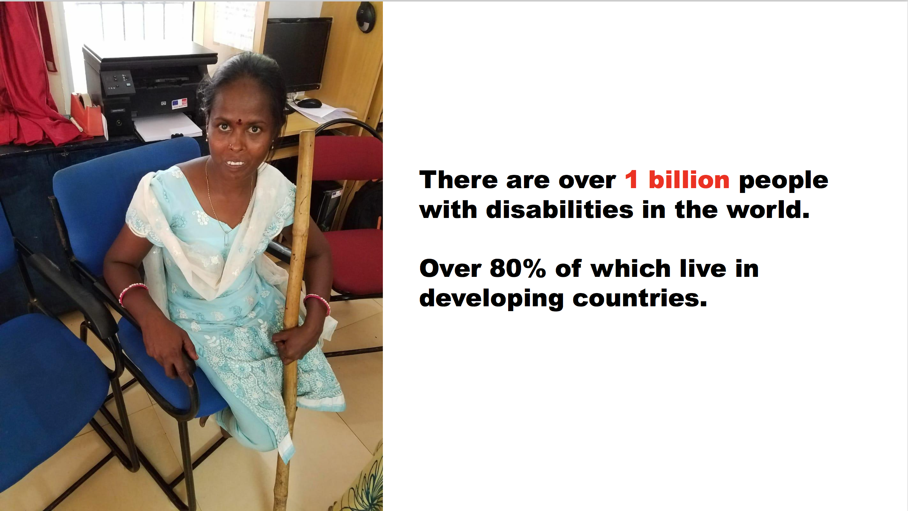
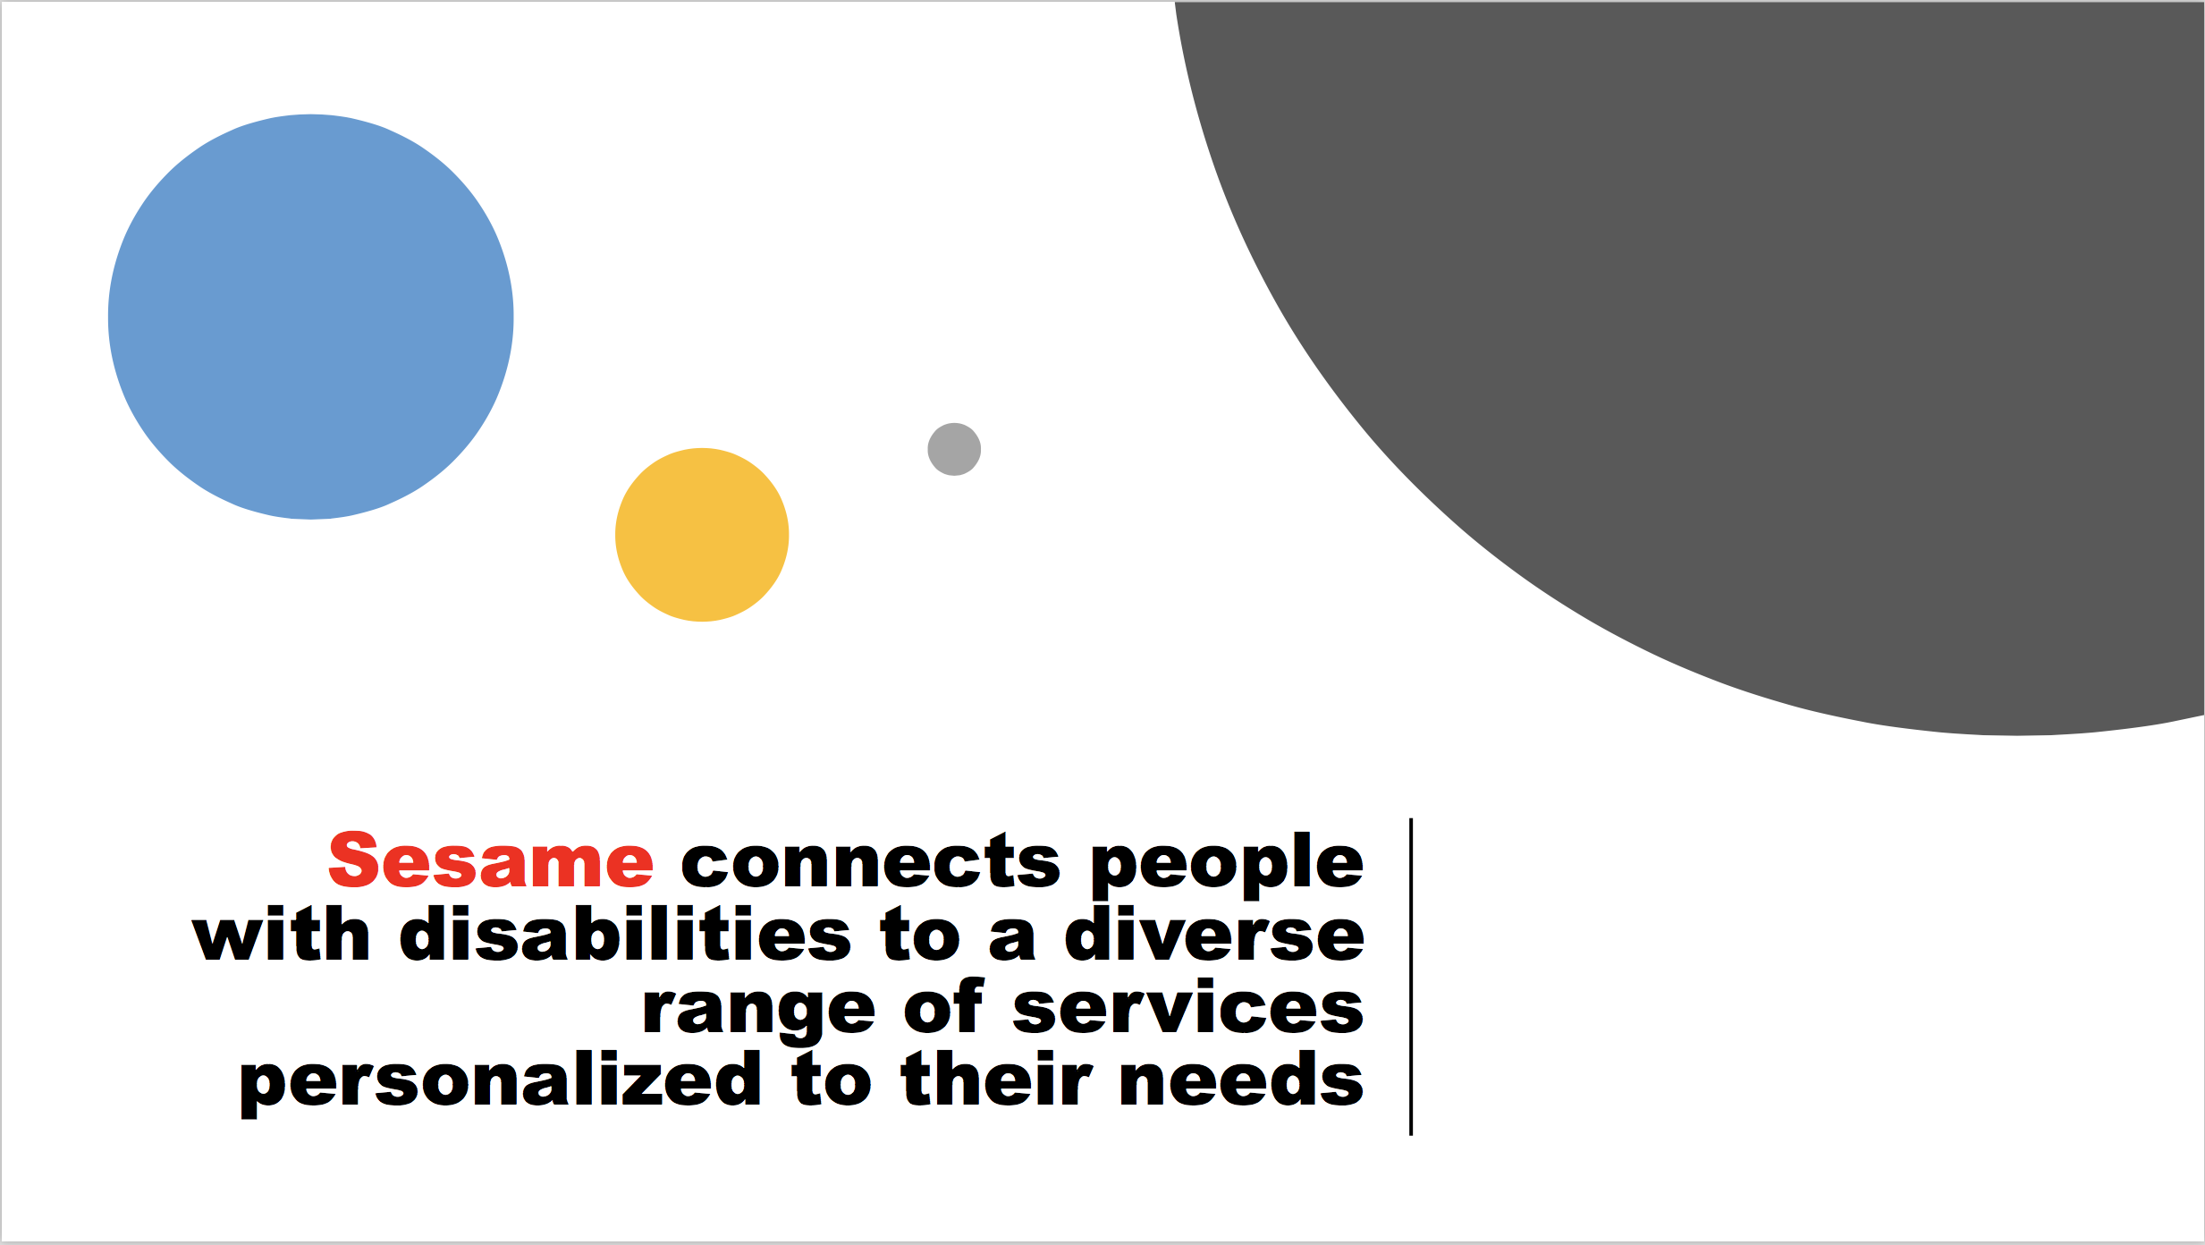
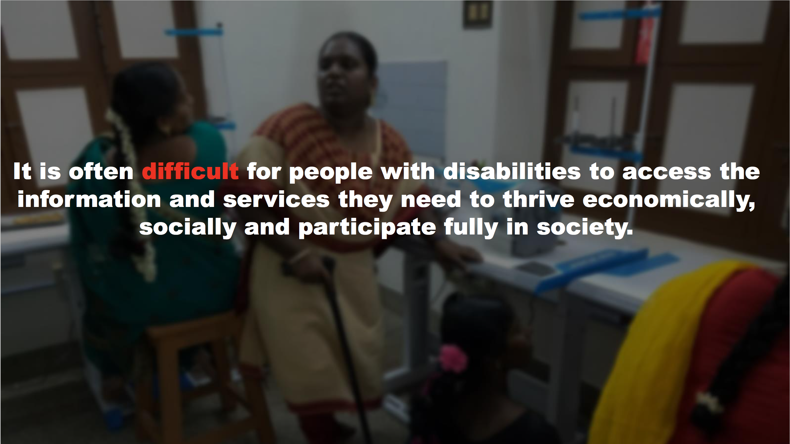
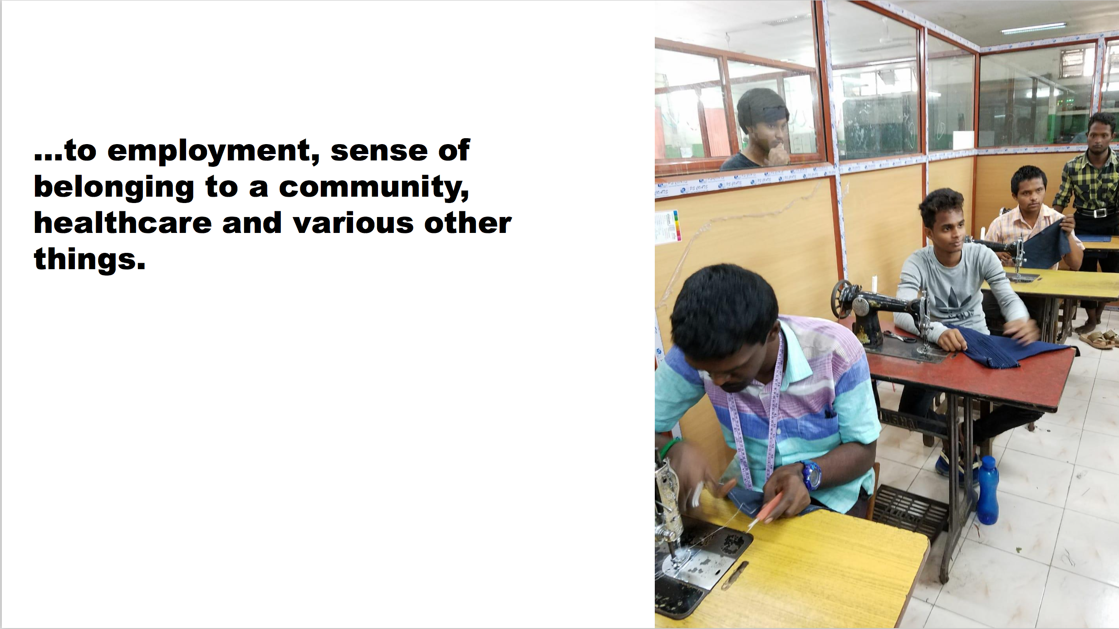
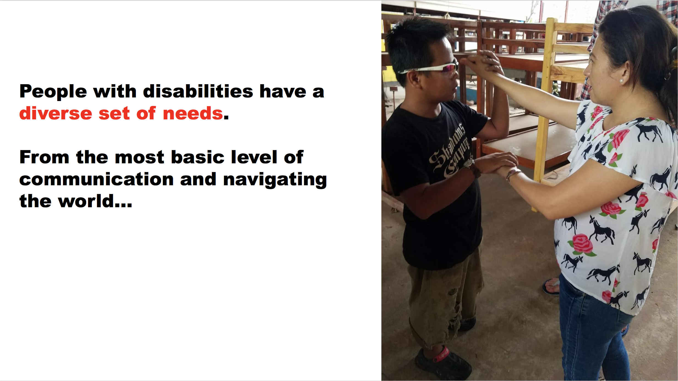

Slide 7

Document Analysis
Health Insurance and Work Contracts are long and complicated
How best to summarise their contents relevant to disabilities?
How does the document compare to other policies?
How to present this information in a clear and concise way?

Slide 8
Disability KeyWords
Chunking / Leminisation
Document
Chunking / Leminisation
Intersection
Naive Bayes Sentiment Classification
Relevant Sentences /
Document Info Density
Sentiment Score
Document Comparison Score

